Slide 1

Get Shit Fun
Mame Cabinet/Pedestal
http://540.co

Slide 8
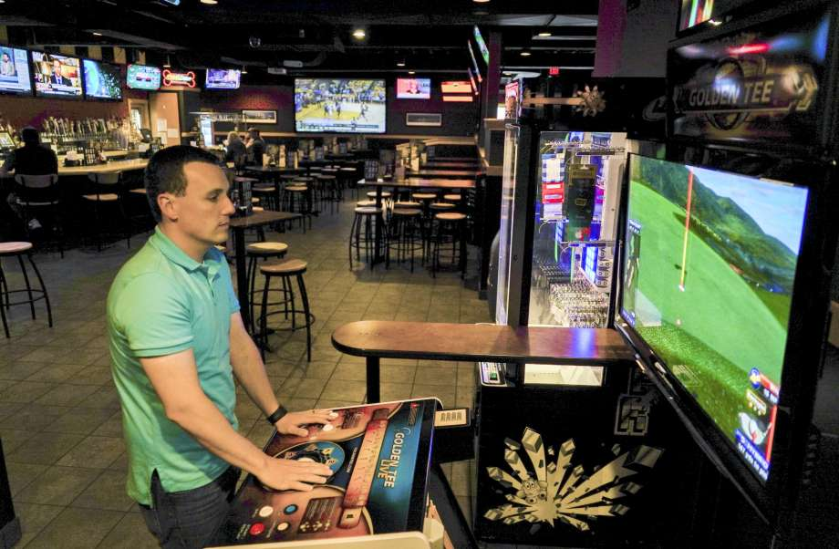

Slide 9
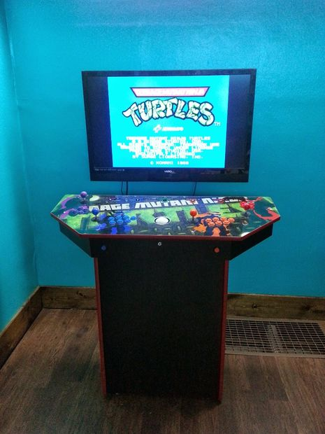
RetroPie MAME Cabinet
http://www.instructables.com/id/4-Player-Pedestal-Arcade-Cabinet-for-MAME/
https://github.com/RetroPie/RetroPie-Setup/wiki/Ports
https://github.com/RetroPie/RetroPie-Setup/wiki/MAME

Slide 10
TODO
Before Hackathon:
Buy Supplies
Pi (might be supplied)
Controllers and Buttons, Trackball
MDF, Pine, Hinge for Cabinet
Cut Wood, Assemble Pedestal
Cut Button and Trackball holes in Console

Slide 11
At Hackathon
At Hackathon
Wire Buttons and Trackball
Configure RetroPi
Paint?
Download games
Bonus:
Custom 540 Interface to select game (Javascript project)
https://github.com/retropie/retropie-setup/wiki/themes

Slide 12
MDF, .75 in 4x8 ft
- 30.00
Full Kit, 4 player
- https://www.amazon.com/Happ-Arcade-Control-Panel-Multi-Color/dp/B00KI3MJ6M/ref=sr_1_1?ie=UTF8&qid=1507303521&sr=8-1&keywords=4+player+mame+cabinet
- 99.00
3" Trackball
- 90.00
- https://www.walmart.com/ip/3-inch-arcade-game-LED-color-changing-trackball-with-USB-and-PS2-interface/377265920?wmlspartner=wlpa&selectedSellerId=11455&adid=22222222227086727278&wmlspartner=wmtlabs&wl0=&wl1=g&wl2=c&wl3=200843251561&wl4=pla-326203800923&wl5=9008163&wl6=&wl7=&wl8=&wl9=pla&wl10=117019192&wl11=online&wl12=377265920&wl13=&veh=sem

Slide 13
Trackball Mount
- https://www.amazon.com/Arcade-Trackball-Metal-Mounting-RetroArcade-us/dp/B01N69OGVD/ref=pd_sim_21_1/133-2978137-3582818?_encoding=UTF8&pd_rd_i=B01N69OGVD&pd_rd_r=PT6YGKH0FJXJR6C9G4AP&pd_rd_w=MUNjs&pd_rd_wg=8cZYR&psc=1&refRID=PT6YGKH0FJXJR6C9G4AP&dpID=41yYw0QmFHL&preST=_SY300_QL70_&dpSrc=detail
- 12.95
Piano Hinge (to open cabinet):
- 5.44 - 20.00
- https://www.woodworkerexpress.com/piano-hinges-piano-continuous-hinges-cut-lengths-length-30-67276.html?utm_source=google&utm_medium=product_search&utm_campaign=google_product_ads&source=googlebase&country=US&gclid=EAIaIQobChMImOKU7u_U1gIVDp7ACh3XfAPsEAQYBiABEgKq1_D_BwE

